Slide 1
SEARCH FOR HEALTH
Way To Strong Life...
Developed By :-
Santosh Sahu - U19CN378
Domain : Android Development...
Notes:
封面标题特殊字体为百度简综艺.可以自行下载使用或改为微软雅黑.

Slide 2
Agenda :
Aim and Objectives
Abstract
Introduction
Literature Survey
Advantage
Requirements
Installation Steps
Sample Source Code
Implementation
Result Analysis
Conclusion
References

Slide 3
Aim and Objectives:
To show a way to a good life.
To Aware the Knowledge of the medicines to people.
To Aware the differences of the medicines.
Patients get knowledge on the chemicals used in Medicines.
Patients can prepare there own Ayurvedic Medicine.
Patients can know the side effects causes on using Artificial Medicines for there blood group.

Slide 4
Abstract :
All of the world the Health Issues are common for people, some of people can’t explain the symptoms to the doctors and in medical stores and didn’t get a proper medicines. And also there have the rights to know about the ingredents added in Artificial medicines and in Ayurvedic medicines. To know the information of a medicines of a digease and infections. And to identify the symptoms. Search For Health(SFH) an Android Application give all the information about the medicine and there symptoms with a one search. It shows both the Ayurvedic and Artificial medicines information and they differences also comparisons...

Slide 5
Introduction :
People need to get a knowlege of medicines, such as How both Ayurvedic Medicines and Artificial Medicines are prepared?, In which issue we should take which medicines? and also know about the Side Effects cause on medicines...
To know such things we introduce “Search For Health” an Android Application which gives the advice and information of a medicines and percentage of side effects of a medicine to the user body by the use of user blood group.
It gives 6 types of information - Ayurvedic Medicines and there side effects, Artificial Medicines and there side effects, Ayurvedic Ingredents, Artificial Ingredents, Body Exercises and Avoidance...

Slide 6
LITERATURE SURVEY 1 :
Revival and retrieval of texts from ancient manuscripts/ rare books, collection and compilation of references relating to drugs and diseases from classical treatises, lexicographic work, contemporary literature and publications related to Ayurveda and other medical systems have been continued further under the Literary Research Programme. The Council has been publishing periodicals "Journal of Research in Ayurvedic Sciences", "Journal of Drug Research in Ayurveda Sciences" and "Journal of Indian Medical Heritage". So far about 235 books, monographs, technical reports etc. have been published besides IEC material like brochures, booklets etc. for dissemination of Ayurveda among masses.

Slide 7
LITERATURE SURVEY 2 :
As per (Rekha and Gokila, 2015) many consumers experienced one or more chemicals in the cosmetics, which could lead to many side effects. Hence, they have started moving to herbal based cosmetics. Most of the cosmetic manufacturing company, after assessing the need of the consumer, started providing herbal based cosmetics. As per the empirical study conducted by Kaur (2016) (http://eminencejournal.com/images/pdf/Z10.pdf), most of the people surveyed were found to be satisfied with the quality and price of herbal cosmetic products (Khanna, 2015). Their study concludes, the majority of the users were satisfied from Patanjali products. The reasons for the same are rational price of the product as well as capability of the product to treat the problem

Slide 8
LITERATURE SURVEY 3 :
The economic burden on drug budgets has increased in the use of generic medicines [1] as those medicines typically 20% to 90% cheaper than originator equivalents [2]. In this case, the usage of inexpensive generic medicines is frequently promoted as a measure to decrease the health care expenses on the pharmaceutical products, and afford savings to patients as well as governments

Slide 9
LITERATURE SURVEY 4 :
Since 1950, there has been an identification of the chemical components in tobacco.[9] Until now, almost 7,000 chemical compounds have been identified in cigarette smoke. Of the 7,000 chemical compounds, 69 of them are known to be carcinogenic.[10] Carcinogenic compounds are present in cigarette smoke such as acetaldehyde, arsenic, benzene, cadmium, ethylene oxide, formaldehyde, polonium nickel (Figure 1).[11] Smoking is enjoying burned nicotine. Nicotine is a

Slide 10
LITERATURE SURVEY 5 :
Globally, there has been a decline in the number of smokers over the age of 15 from 23.5% in 2007 to 20.7% in 2015.[5] There are several factors related to the decrease in the prevalence of smokers, namely increases in tobacco taxes and prices, anti-tobacco campaigns, access to services to stop using tobacco, and government regulations regulating tobacco products.[6] The prevalence of smokers in Indonesia has increased from 7.2% in 2013 to 9.1% in 2018 in smokers aged 10-18 years.[2] Every year, more than 7 million deaths are caused by cigarette use

Slide 11
ADVANTAGE :
Comparison of both Ayurvedic and Artificial Medicines
Side Effects of Medicines
Body Exercises
Avoids and Warning
Ingredents of medicines
Fully Information of a diseage or infections

Slide 12
REQUIREMENTS :
Hardware Requirements:
Android Device Setup...
Except Iphones...
Software Requirements:
Operating System: Windows 10 above and Above i5 core...
Language: Frontend XML, Gradle...
Backend JAVA/Kotlin...
Tool: Android Studio...

Slide 13
Installation Steps:
Step - 1: Developer share the App to the Users by APK file format.
Step - 2: Users Downloads the APK file on there Devices, Available At File Manager. Except Iphones.
Step - 3: Users dont need to give Permission or no need to login.

Slide 14
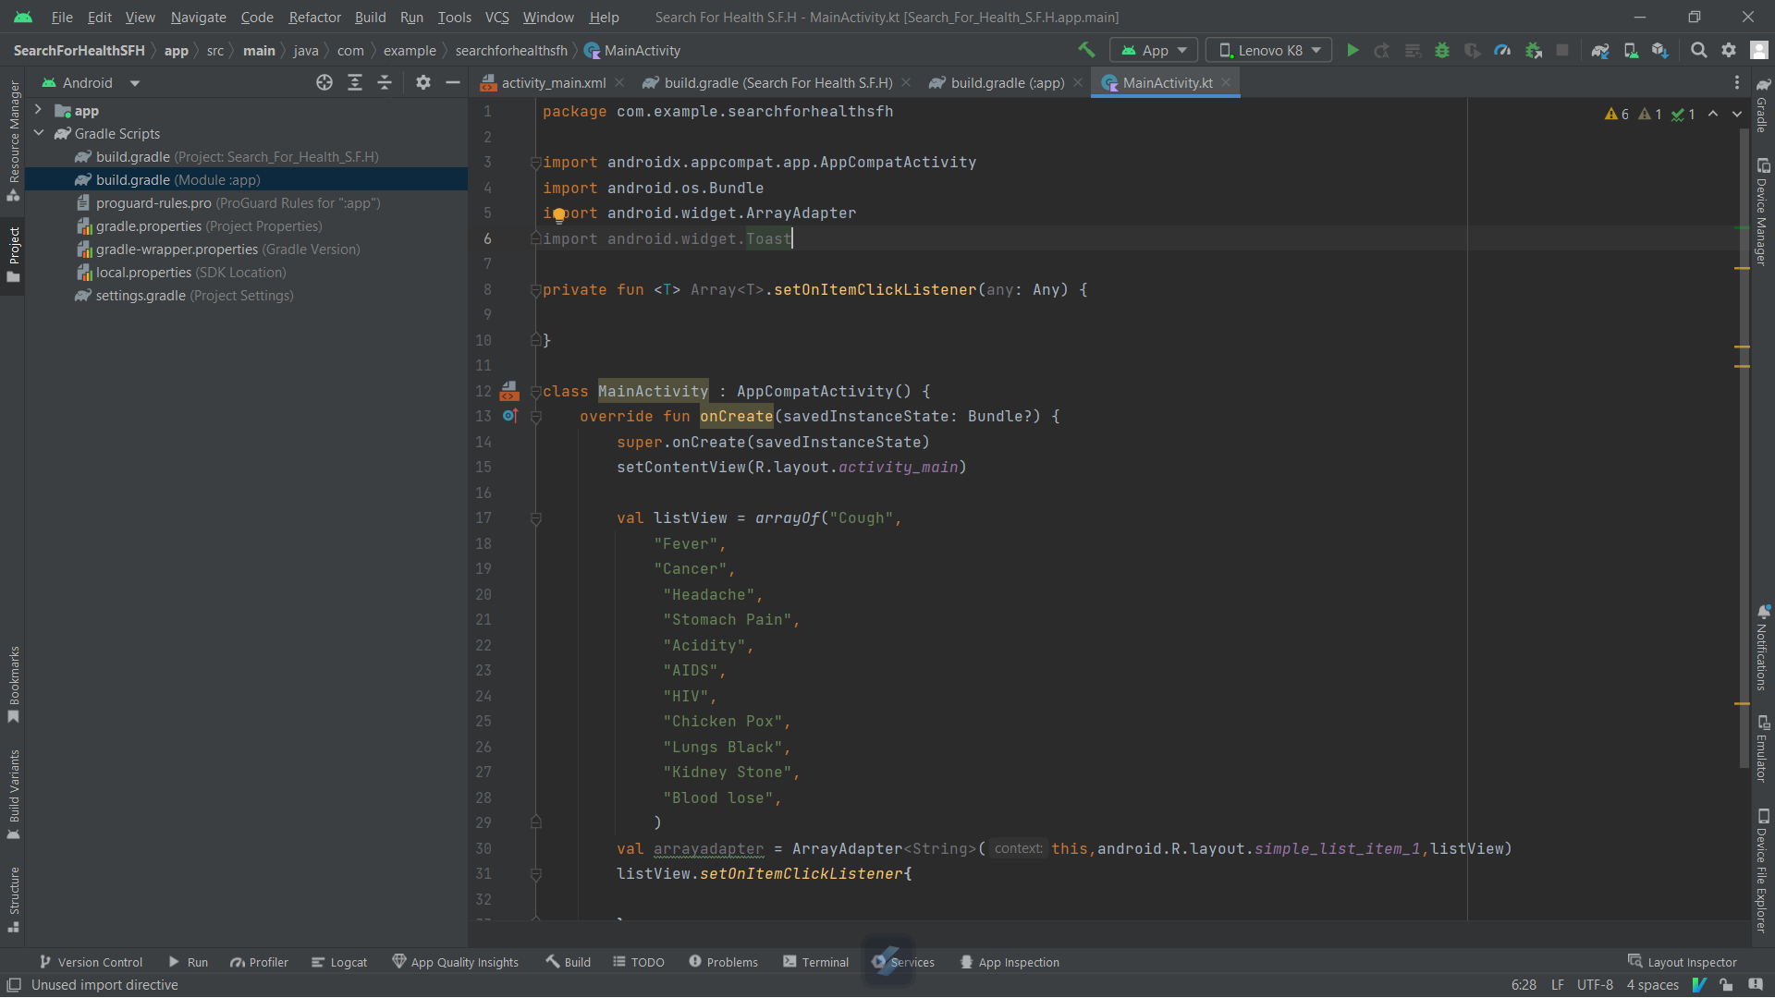
SAMPLE SOURCE CODE 1:
MainActivity(Java/Kotlin)...

Slide 15
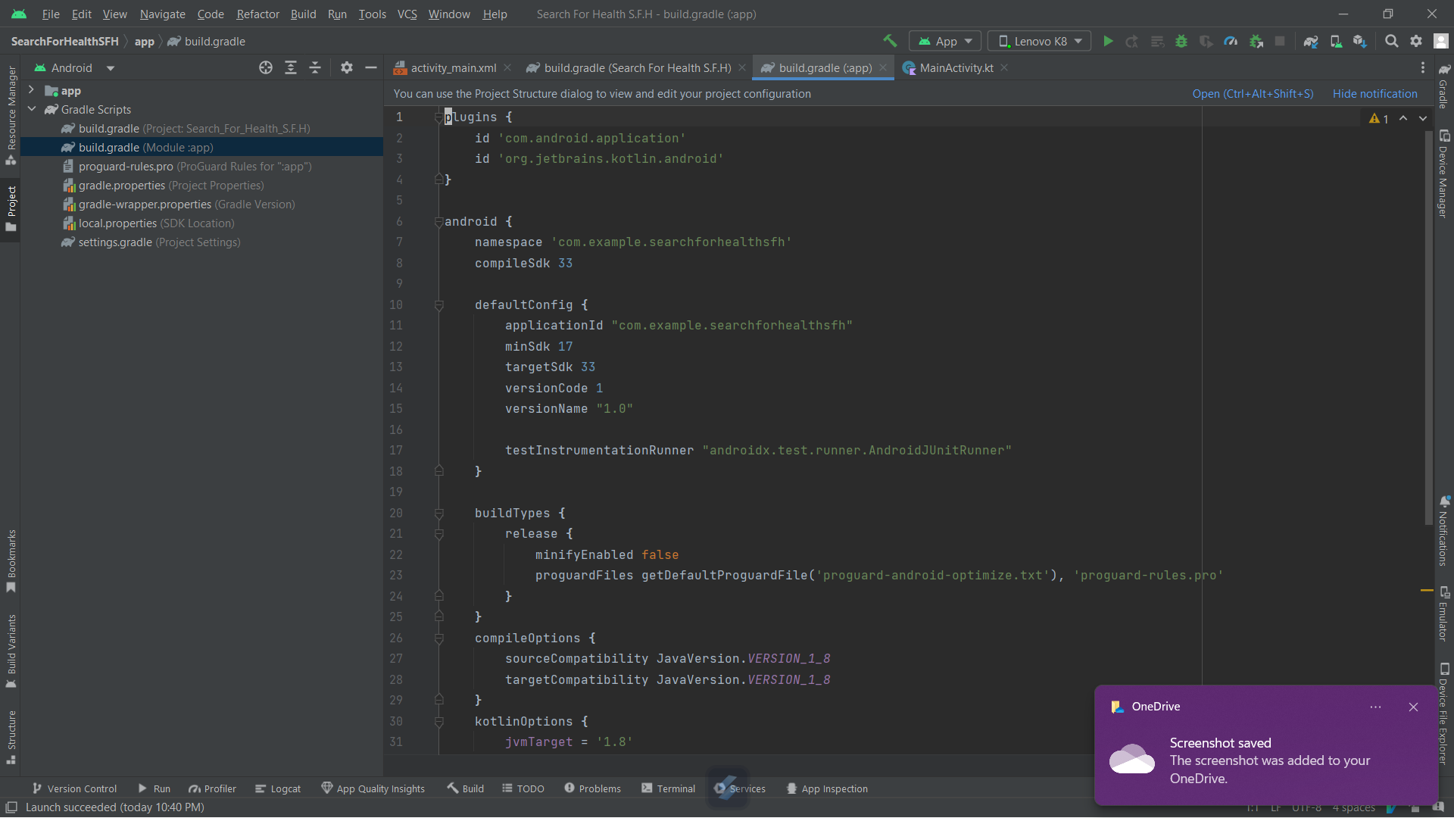
SAMPLE SOURCE CODE 2:
build.gradle

Slide 16
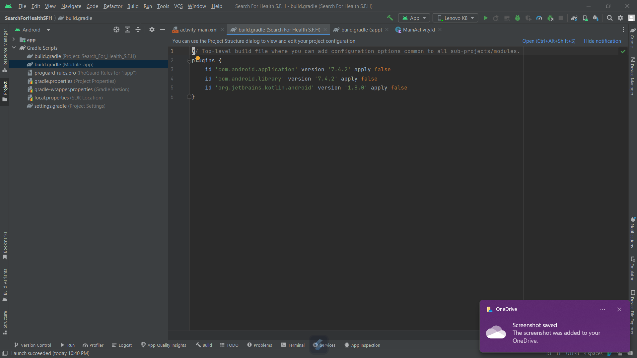
SAMPLE SOURCE CODE 3:
build.gradle(S.F.H)

Slide 17
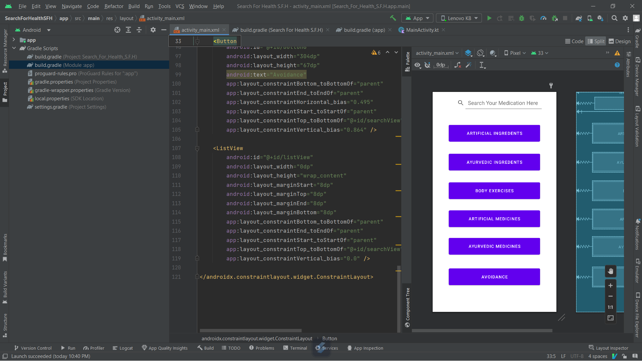
SAMPLE SOURCE CODE 4:
activity_Main.xml (XML code)

Slide 18
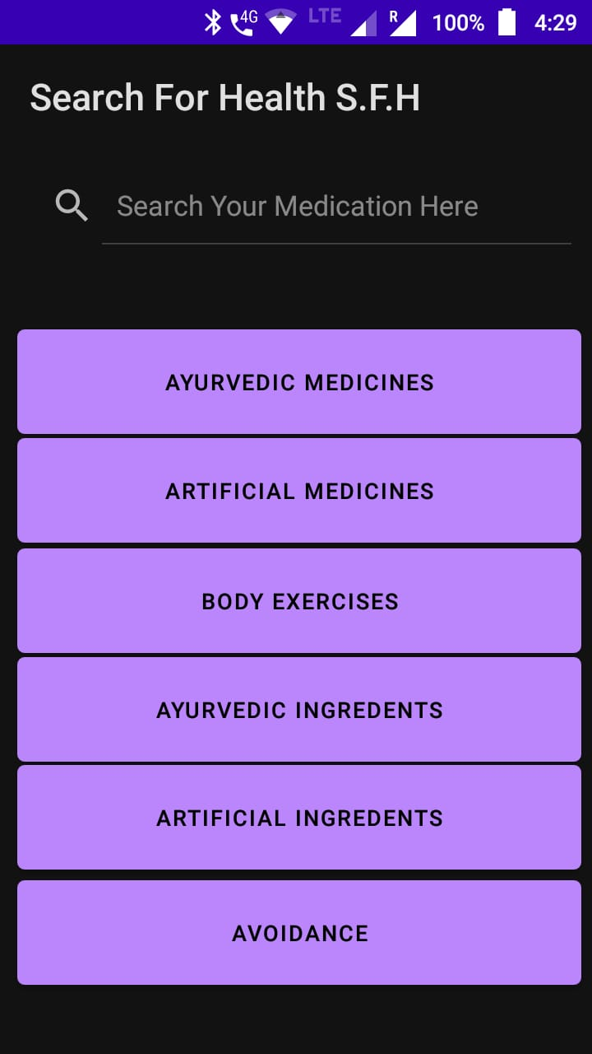
IMPLEMENTATION 1:
First Page of the App...

Slide 19
IMPLEMENTATION 2:
Cough
First Page of the App...

Slide 20
IMPLEMENTATION 3:
Cough
User Blood Group = B+
Second Page of the App...

Slide 21
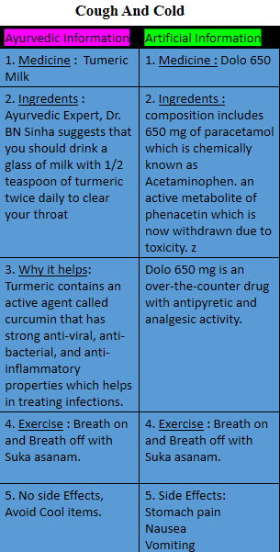
RESULT ANALYSIS:
BACK
Cough
Third Page of the App...

Slide 22
CONCLUSION:
User after giving the issue and blood group, he get the Differences of that issue as Ayurvedic and Artificial Informations.
Also there side effects and body exercises.
Also Avoids of Past foods and other bad roles.

Slide 23
REFERENCE:
National Institutes of Health Office of Dietary Supplements. Botanical Dietary Supplements: Background Information. Available at http://ods.od.nih.gov/factsheets/botanicalbackground.asp. Accessed 12 December 2012.
Duraz AY, Khan SA. Knowledge, attitudes and awareness of community pharmacists towards the use of herbal medicines in muscat region. Oman Med J 2011;26:451-3.
Kirking DM et al. Economics and structure of the genericpharmaceutical industry. J Am Pharm Assoc (Wash) 2001;41(4): 578–584.4.
Pearce GA et al. Bioequivalence: how, why, and what does itreally mean? J Pharm Pract Res 2004; 34: 195–200
Lofgren H. Generic drugs: international trends and policydevelopments in Australia. Aust Health Rev 2004; 27(1): 39–48
De Quincey T. Confessions of an English Opium Eater. Oxford University Press. 1821; 39–40 [Google Scholar]
Burroughs W. Junkie. New English Library, London 1953 [Google Scholar]
World Health Organization. Tobacco [Internet]. Geneva: World Health Organization; 2019 May [cited 2020 Jan 04]; Available from: https://www.who.int/news-room/fact-sheets/detail/tobacco
Tirtosastro S, Murdiyati AS. Kandungan kimia tembakau dan rokok. Buletin Tanaman Tembakau, Serat & Minyak Industri. 2010;2(1):33-43.
Better Balance Book written by Harvard Universy Website. Available At https://www.health.harvard.edu/topics/exercise-and-fitness

Slide 24


